Slide 1
Chemistry – Week of April 13 Lesson #2
P3 Challenge –
Determine the molar mass of Fe(NO₃)₃
Today’s Objective –
  Mass Percentage and Empirical Formulas
Agenda
  Mass percent (review)
  Mass percent from formulas
  Empirical formula from mass percent
  Molecular formula
Assignment:
  Empirical Formula Worksheet

Slide 2
Mass Percent Composition (Review)
Given the number of grams of each element in a sample of a compound, you can calculate the mass percent composition.
Ex: Experiment shows a 43.8 g sample of sodium chloride contains 17.2 g of sodium. What is the mass percentage of each element in sodium chloride?

Slide 3
Determine mass percentage from formula
Because a chemical formula represent relationships of moles of elements, you can determine the mass percent of any substance using molar masses. No experiment is needed!

Slide 4


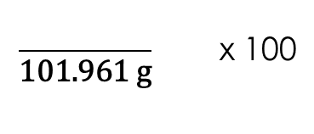



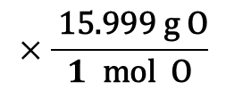

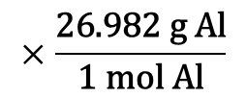

Sample Percentage from Formula
Determine the percent composition of each element in Al₂O₃
$$×\frac{\text{26.982} \text{g} \text{Al}}{\text{1 }\text{mol} \text{Al}}$$
$$= \text{53.964} \text{g} \text{Al}$$
2$\text{mol} \text{Al}$
$\frac{}{\text{101.961}\text{g}}$ x 100
$$= \text{52.93 \%} \text{Al}$$
$$×\frac{ \text{15.999} \text{g} \text{O}}{1 \text{mol} \text{O}}$$
$$= \text{47.997} \text{g} \text{O}$$
3$\text{mol} \text{O}$
$$\frac{}{\text{101.961} \text{g}} \text{x}\text{ 100}$$
$$=47.07\text{\%} \text{O}$$

Slide 5
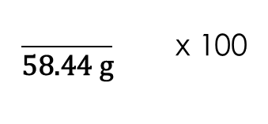





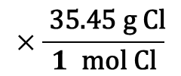

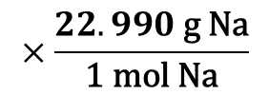

Practice Percentage from Formula
Ex: Find the mass percentage of each element in NaCl. Verify that you get the same results we got from an experimental analysis. (39.3% Na, 60.7%Cl)
$$×\frac{22.990 \text{g} \text{Na}}{\text{1 }\text{mol} \text{Na}}$$
$$= \text{22.990 }\text{g} \text{Na}$$
$$1 \text{mol} \text{Na}$$
$\frac{}{\text{58.44 }\text{g}}$ x 100
$$= \text{39.34 \%} \text{Na}$$
$$= \text{35.45 }\text{g} \text{Cl}$$
$$×\frac{ \text{35.45 }\text{g} \text{Cl}}{1 \text{mol} \text{Cl}}$$
$$\frac{}{\text{58.44 }\text{g}} \text{x}\text{ 100}$$
$$1 \text{mol} \text{Cl}$$
$$= \text{60.66}\text{ \%} \text{Cl}$$

Slide 6
Determining Empirical Formulas
If you know the mass percentage of a compound, you can determine its chemical formula, most of the time. (Go backwards)
Because this chemical formula is found from data, it is an empirical formula.
Assume you have 100 g of a substance and write the percent composition in terms of grams of each element
Convert these masses to moles.
Divide by the smallest result.
You should get integers. (If you get a decimal, multiply all by a factor to get integers.)
Write your empirical formula. Often you can name the result.

Slide 7
Fractions and Decimals
When you divide by the smallest number of moles, you won’t always get integers.
If you get a decimal quantity, it reveals a different ratio based on halves, thirds, quarters etc…
Use this table to decide what to multiply by to get integers.
Fraction form | Decimal form | Multiply by
1/2 | 0.5 | 2
1/3, or 2/3 | 0.333, 0.666 | 3
1/4, or ¾ | 0.25, 0.75 | 4
1/5, 2/5, 3/5, 4/5 | 0.2, 0.4, 0.6, 0.8 | 5

Slide 8



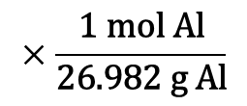

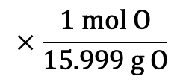




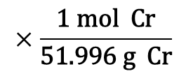







Sample Empirical Formula Problem
A compound is found to contain 13.42% Al, 38.81% Cr, and 47.77% O. Determine the empirical formula for this compound.
$$13.42 \text{g} \text{Al}$$
$$×\frac{\text{1 }\text{mol} \text{Al}}{\text{26.982} \text{g} \text{Al}}$$
$$= \text{0.4974 }\text{g} \text{Al}$$
$\frac{}{\text{0.4974 }\text{g}}$
$$= \text{1 }\text{Al}$$
$$×2= \text{2 }\text{Al}$$
$$38.81 \text{g} \text{Cr}$$
$$×\frac{\text{1 }\text{mol} \text{Cr}}{\text{51.996} \text{g} \text{Cr}}$$
Al₂Cr₃O₁₂
$$= \text{0.7464} \text{g} \text{Cr}$$
$\frac{}{\text{0.4974 }\text{g}}$
$$= \text{1.5 }\text{Cr}$$
$$×2= \text{3 }\text{Cr}$$
Al₂(CrO₄)₃
$$×\frac{\text{1 }\text{mol} \text{O}}{\text{15.999} \text{g} \text{O}}$$
$$47.77 \text{g} \text{O}$$
$$= \text{2.986 }\text{g} \text{O}$$
$$\frac{}{\text{0.4974 }\text{g}}$$
$$= \text{6 }\text{O}$$
$$×2=1\text{2 }\text{O}$$
Aluminum Chromate

Slide 9







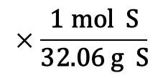






Determine Empirical Formula
You can also use experimental masses.
Ex: A particular sample contains 9.56 g Al, 17.04 g S, and 25.30 g O. What is the empirical formula of this substance?
$$9.56 \text{g} \text{Al}$$
$$×\frac{\text{1 }\text{mol} \text{Al}}{\text{26.982} \text{g} \text{Al}}$$
$$= \text{0.3543 }\text{g} \text{Al}$$
$\frac{}{\text{0.3543 }\text{g}}$
$$= \text{1 }\text{Al}$$
$$×2= \text{2 }\text{Al}$$
$$17.04 \text{g} \text{S}$$
$$×\frac{\text{1 }\text{mol} \text{S}}{\text{32.06} \text{g} \text{S}}$$
Al₂S₃O₉
$$= \text{0.5315} \text{g} \text{S}$$
$\frac{}{\text{0.3543 }\text{g}}$
$$= \text{1.5 }\text{S}$$
$$×2= \text{3 }\text{S}$$
Al₂(SO₃)₃
$$×\frac{\text{1 }\text{mol} \text{O}}{\text{15.999} \text{g} \text{O}}$$
$$25.30 \text{g} \text{O}$$
$$= \text{1.581 }\text{g} \text{O}$$
$$\frac{}{\text{0.3543 }\text{g}}$$
Aluminum Sulfite
$$= \text{4.5 }\text{O}$$
$$×2=\text{9} \text{O}$$

Slide 10
Empirical Formula
Most of the time, an empirical formula is the same as a molecular chemical formula, but not always.
Consider a compound A that is 40.0% carbon, 6.7 % hydrogen and 53.3% oxygen.
Determine the empirical formula of this compound.
CH₂O
Now what if I told you the molar mass of this compound is 180 g/mol?

Slide 11
From Empirical Formula to Molecular Formula
In order to determine the molecular formula, you also need to know the molar mass of the compound.
Divide the molar mass by the molar mass of the empirical formula.
Multiply your empirical formula by this factor to determine the molecular formula.
For our last problem, 180 g/mol / 30g/mol = 6. C₆H₁₂O₆

Slide 12
Exit Slip - Homework
Exit Slip: A compound is found to contain 55.27% Sn, 14.93% S, and 29.80% O. Determine the empirical formula for this compound. Then name the substance.
SnSO₄ tin (II) sulfate
What’s Due?
  Empirical Formula worksheet

